Slide 1
DAKA_AGRP (RADIANT GLOBAL LOGISTICS DBA AIRGROUP IAH)
Always key the following, visible in the invoice separator sheet:
Batch ID (68) BAT ID (69) Value/No
Client Code (68) CL CODE (69) DAKA
Scac Code (68) SCAC CODE (69) AGRP

Slide 2
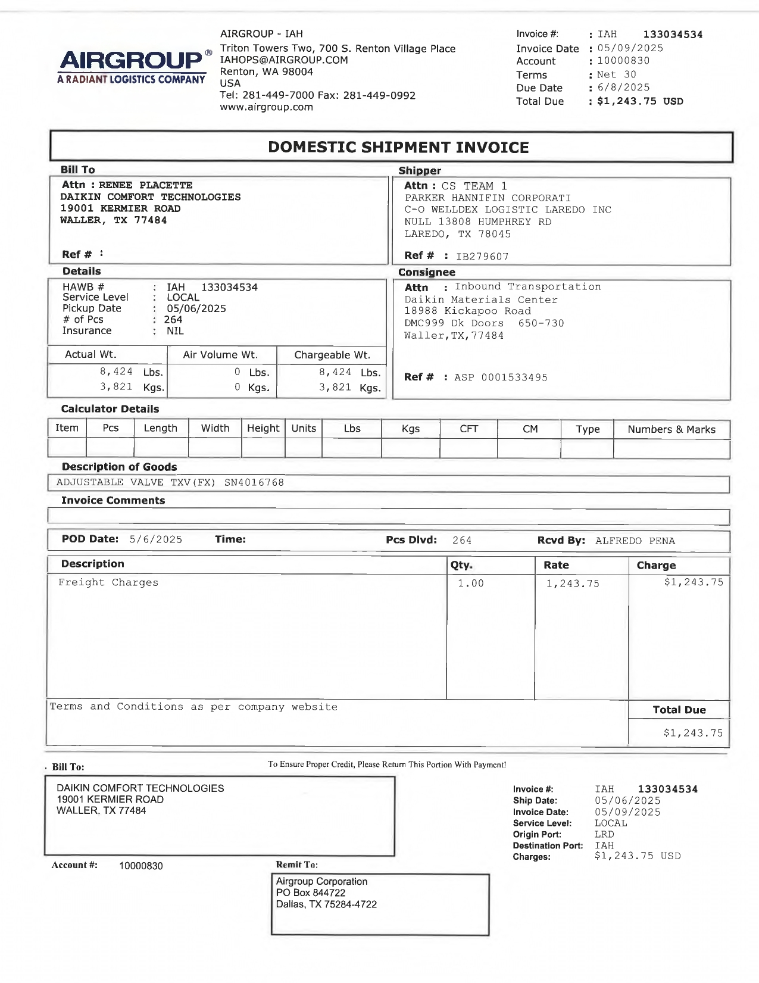
03
FORMAT A
10
11
01
02
27
01 REMIT TO
02 BILL TO
03 INV KEY
05 ACCT NO
10 DATE
11 DUE
27 SHIPPER INV
27.9 SHIPPER INV
30 CONSIGNEE INV
30.9 CONSIGNEE INV
38 SRVC LEVEL
42 ACTUAL WT
44 ACTUAL WT UOM
43 FNCL WT
45 FNCL WT UOM
46 PIECES
47 PIECES TYPE
58 RECEIVED BY
61 PICK UP
68a REF
68b HAWB
72 LINE ITEM DESC
74 LINE ITEM QTY
75 LINE ITEM RATE
85 LINE ITEM AMT
90 PROD DESC
08/14 INV AMT/ FB AMT
68b
68a
30
38
61
44
42
68a
43
45
47
46
58
90
72
74
75
85
08/14
27.9
30.9
05

Slide 3
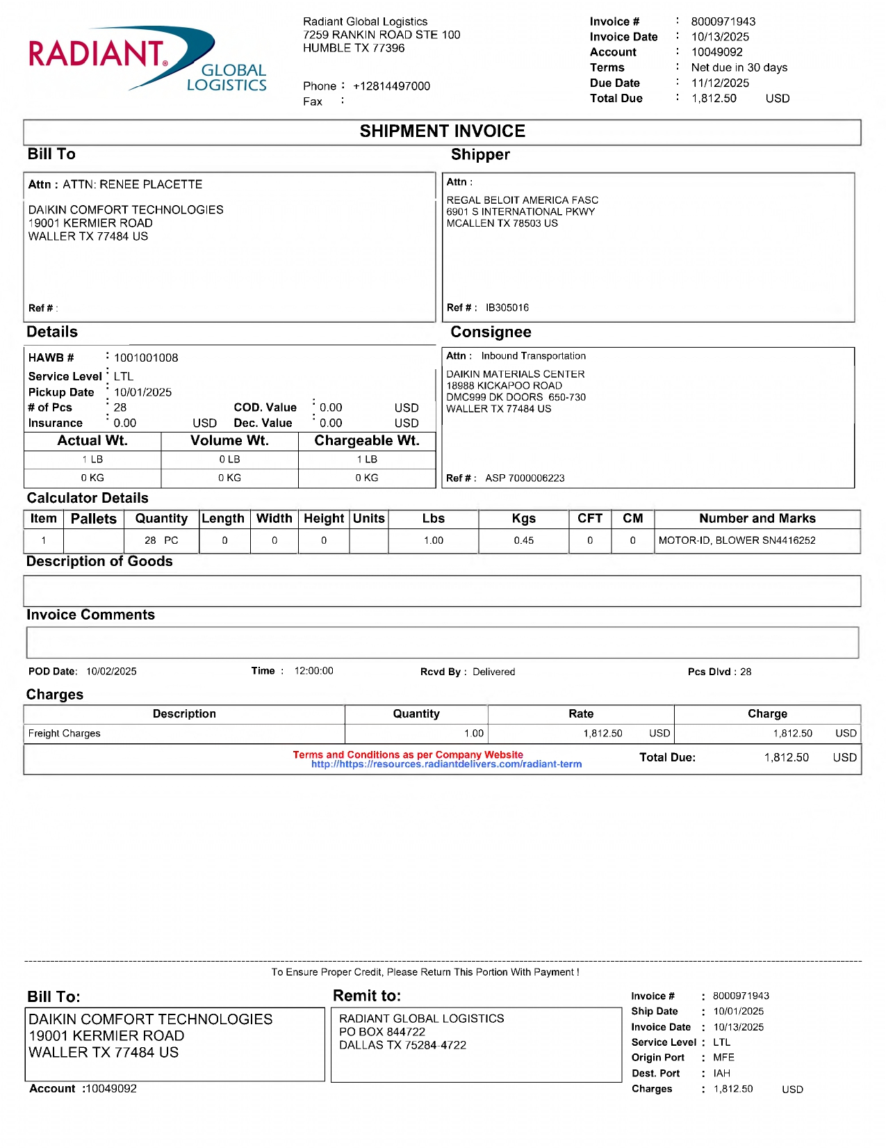
05
03
01
10
FORMAT B
11
02
27
68a REF
68b HAWB
01 REMIT TO
02 BILL TO
03 INV KEY
05 ACCT NO
10 DATE
11 DUE
27 SHIPPER INV
27.9 SHIPPER INV PORT
30 CONSIGNEE INV
30.9 CONSIGNEE INV PORT
38 SRVC LEVEL
42 /43 ACTUAL WT/ FNCL WT
44/45 WT UOM
46 PIECES
47 PIECES TYPE
53 VOLUME
54 VOLUME UOM
61 PICK UP
72 LINE ITEM DESC
74 LINE ITEM QTY
75 LINE ITEM RATE
85 LINE ITEM AMT
08/14 INV AMT/ FB AMT
09 CURR
68a
68b
61
38
30
53
43/45
42
68a
44
54
47
46
85
72
74
75
09
08/14
27.9
30.9

Slide 4
6
For Verification Table
 | NAME | DATE
DI-70791 | BABY G. VILLACARLOS | 05/27/2025
DI-75249 – Added FORMAT B | CIDJANE J. LOCAYLOCAY | 10/27/2025

